Slide 1
Milestone 1
CS 6460
Team Awesome

Slide 2
Overview
Connect to a research paper database to allow an AI to read over the papers and return values that will be stored in a separate database.
Use AI to interpret a researcher’s search criteria and pull papers that are relevant.
Allow a user to upvote/downvote papers, which will help teach the AI to return better results over time for an individual's queries.
Allow researchers to have the ability to log in, store papers, and restore previous sessions.

Slide 3
What has been achieved until now?
Springer service to connect to the Springer endpoint to retrieve research papers
Watson service to connect to the Watson API to extract concepts for a paper
DB service to put concepts and papers in the database on Amazon cloud
Loader service which uses all the above services to populate our database.

Slide 4
Use Case Diagram
This diagram displays the possible use-cases through a user interface.
When the user logs in, they have capabilities such as sessions and the ability favorite papers.
Whether logged in or not, the user can search, sort, and view papers over a variety of methods, as well as rate results up or down.

Slide 5
Sequence Diagram for Loading Service
The loading service picks papers from the springer service
It then sends the contents of each paper to watson
Watson extracts concepts from the paper and returns the set of concepts
The loading service then adds the paper and its concepts to the DB which is on AWS.

Slide 6
Sequence Diagram for Search Service
The user inputs a search query
The search service uses watson to convert the query into a list of concepts
The search service then queries the DB for the papers that have those concepts in them
The user is then returned a list of papers.

Slide 7
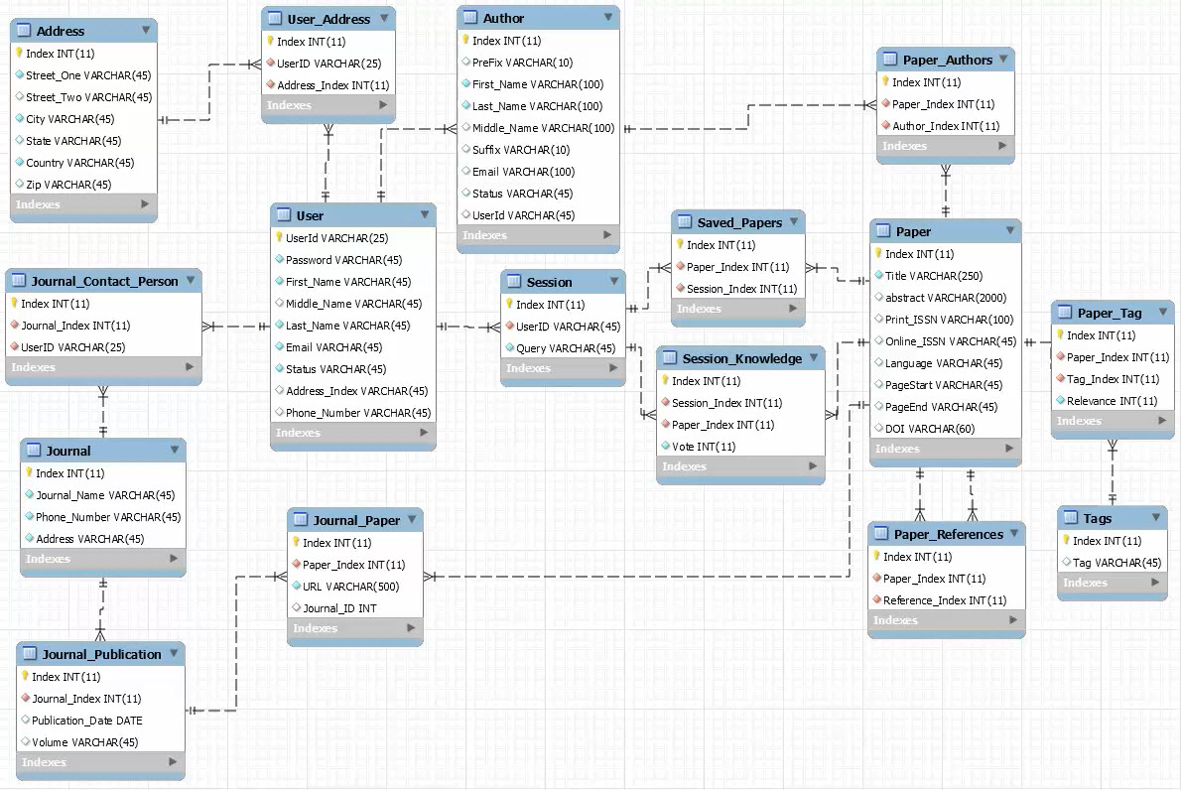
ER Diagram

Slide 8
ER Diagram Tables
Author - stores author name and makes connection to papers
Journal - stores journal name, contact and makes connection to its publications
Journal_Publication - store publication date and makes connection to Journal and papers, along with URL for paper.
Paper - stores metadata of paper and makes connection to tags (concepts), author(s), and publication.
Session - stores a user queries and has connections to saved papers and any voting on papers
Session Knowledge - stores the voting for papers
Tags - stores concept terms and has connection to paper_tags.
User - stores information about the user.

Slide 9
Tools used
GATech Github to manage the project code : https://github.gatech.edu/dstevens34/6460/
Amazon Web Services for the backend
IBM Watson through IBM BlueMix for AI : https://console.ng.bluemix.net
Springer OpenAccess API for research papers : https://dev.springer.com/
MySQL Workbench to work with the DB
Python to quickly prototype the project’s code, all the code can be found in the github repository.

Slide 10
What is left ?
Search service to query our database
Add function to watson service to extract concepts from the search query.
Service to let users log in and rank papers
Front end for the users
Create backend which connects the front end to our services and database.

